Slide 1
SYSTEM SOFTWARE AND COMPILERS-18CS61

Slide 2
Module-1
ASSEMBLERS AND LOADERS

Slide 3
Module 1
Introduction to System Software: Machine Architecture of SIC and SIC/XE.
Assemblers: Basic assembler functions, machine dependent assembler features, machine independent assembler features, assembler design options.
Loaders: Basic Loader Function

Slide 4
Textbook
Leland L. Beck,
"System Software: An Introduction to Systems Programming"
(3rd Edition), published by Addison Wesley.

Slide 5
Introduction
Hardware:
The physical components which makeup the computer system.
Software:
The set of programs that tells the computer to perform various jobs
A program is a set of instructions given to the computer to perform some specific task

Slide 6
Introduction
Software can be classified into:
Application software usually used by end-user
It is concerned with the solution of some problem, using the computer as a tool, instead of how computers actually work.
Eg: MS Word, Internet Explorer, ORACLE
System software
System software consists of a variety of programs that support the operation of a computer (ex: text editor, compiler, debugger)
One characteristic in which most system software differ from application software is machine dependency
A system software programmer must know the target machine structure

Slide 7
Difference between System Software and Application Software
System Software | Application Software
Programs that help the user to interact with the hardware components | Programs written for a specific need of the user
Control and manage hardware | Uses the services of the system software to interact with hardware
These programs are machine dependent | These are machine independent
Programmer should be familiar with machine instruction formats, architecture and so on | Programmer should be familiar with programming language constructs.
Example: Compilers, Assemblers, Operating System | Example: Banking Software, MS office suit, Web browsers.

Slide 8
System Software and Machine Architecture
Machine dependent system software
System programs are to support the operation and use of the target computer.
The difference between different machine
Machine code
Instruction formats
Addressing mode
Registers
Machine independent system software
General design and logic is basically the same:
Code optimization
General design and logic of an assembler

Slide 9
System Software
The system software includes
Assembler
Linker
Loader
Macro processor
Text editor
Compiler
Operating system
Debugging system
Source Code Control System
(optional) Database Management System

Slide 10
Simplified Instructional Computer (SIC)
A hypothetical computer that includes the hardware features most often found on real machines
SIC standard model
SIC/XE [extra equipment/ extra expensive]
Upward compatible
Programs for SIC can run on SIC/XE
Notes:
The two versions are upward compatible, that is program written for SIC will also execute properly on SIC/XE

Slide 11
SIC machine architecture
The architecture of the SIC machine depends on the following features:
Memory
Registers
Data Formats
Instruction Formats
Addressing Modes
Instruction Set
Input and Output

Slide 12
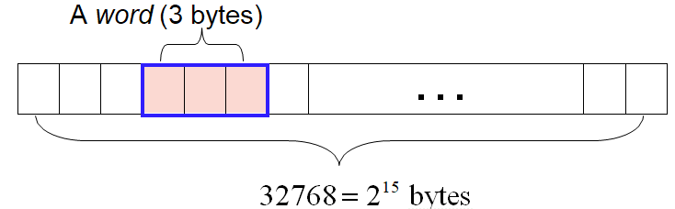
SIC machine architecture
Memory
8-bit bytes
3 consecutive bytes form a word
Addressed by the lowest number byte
215 (32768) bytes in the computer memory
0 | 0 | 0 | 0 | 0 | 0 | 0 | 0 | 0 | 0 | 0 | 0 | 0 | 0 | 0
Starting Address: 0000H
1 | 1 | 1 | 1 | 1 | 1 | 1 | 1 | 1 | 1 | 1 | 1 | 1 | 1 | 1
Ending Address: 7FFFH

Slide 13
SIC machine architecture
Registers (5 registers / each 24-bits)
Mnemonic | Number | Special use
A | 0 | Accumulator; used for arithmetic operations
X | 1 | Index register; used for addressing
L | 2 | Linkage register; the Jump to Subroutine (JSUB) Instruction Stores the return address in this register
PC | 8 | Program Counter; Contains the address of the next instruction to be fetched for execution
SW | 9 | Status Word; contains the variety of information, including Condition Code CC
SIC does not have any stack. It uses the linkage register to store the return address.
It is difficult to write the recursive program. A programmer has to maintain memory for return addresses when he write more than one layer of function call.
Notes:
Number scheme is chosen for compatibility with XE version

Slide 14
SIC machine architecture
Data formats
Characters
8-bit ASCII codes
Integers
24-bit binary numbers
2’s complement for negative values
No floating-point numbers (exist in SIC/XE)

Slide 15
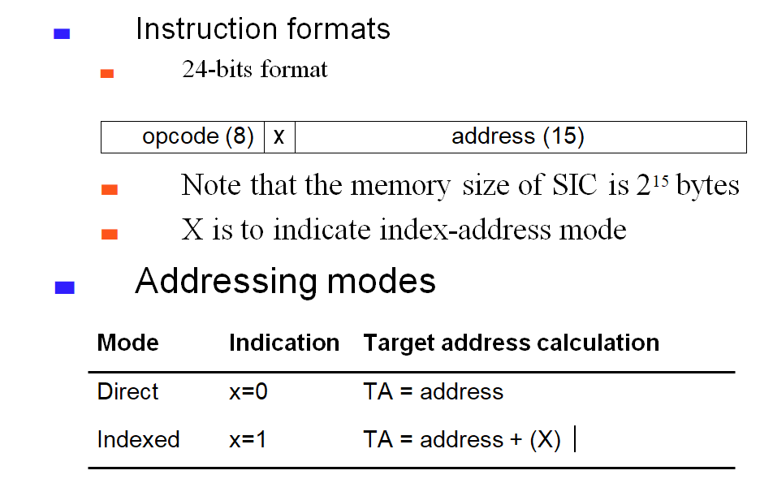
SIC machine architecture
Direct Addressing:
ALPHA WORD X’112233’
……..
……..
LDA APLHA
Indirect Addressing:
ALPHA WORD X’112233’
……..
……..
LDA APLHA, X

Slide 16
SIC machine architecture
Instruction | Example
Load Instructions | LDA,LDX,LDCH | LDA mem-loc: LDA LENGTH LDCH mem-loc: LDCH NUM
Store Instruction | STA,STX,STCH | STA mem-loc: STA LENGTH STCH mem-loc: STCH NUM
Arithmetic Instructions | ADD,SUB,DIV,MUL | ADD ALPHA: A+ALPHA
Compare Instructions | COMP, TIX | COMP NUM TIX-> Test after Incrementing register X TIX m
Conditional Jump Instructions | JLT,JEQ,JGT | JLT L1
Unconditional Jump Instructions | J | J L1
Logical Instructions | AND,OR | AND m
Subroutine Instructions | JSUB,RSUB | JSUB FACT… …………….
FACT……
………
……..
RSUB
Note: RSUB returns by jumping to the address contained in the Register L

Slide 17
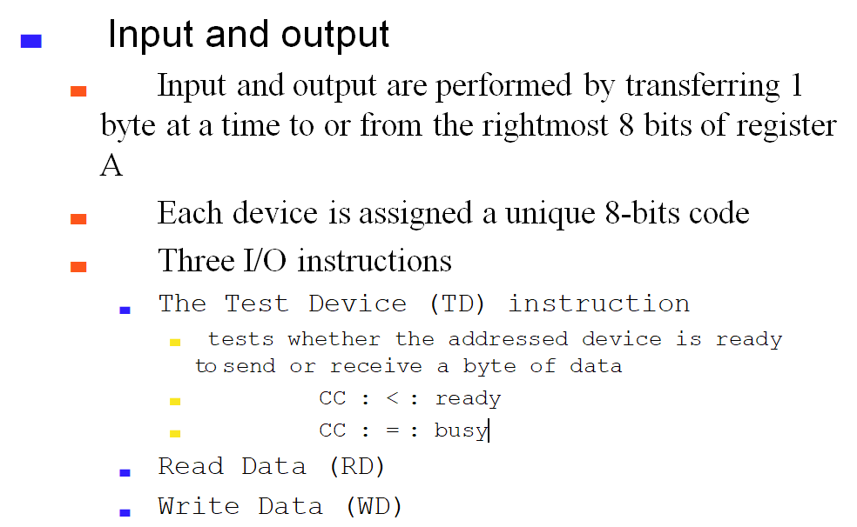
SIC machine architecture
Input Device: “F1”
Output Device: “05”
BACK: TD INPUT Tests whether i/p device is ready or not
JEQ BACK Device is not ready
RD INPUT Read a byte from i/p device

Slide 18
Assembler Directive
The Instructions given to the Assembler
Directive | Syntax | Example | Remarks
WORD | identifier WORD data | NUM WORD 2 NUM WORD X’20’ | Define an Integer 2 Defines an hexadecimal 20
BYTE | identifier BYTE data | NUM BYTE X’F1’ NUM BYTE C’ABCDE’ | F1 occupies 1 byte String “ABCDE” is defined
RESB | identifier RESB data | NUM RESB 10 1000 1009 | Reserves 10 bytes of memory
RESW | identifier RESW data | NUM RESW 3 3 Bytes 3 Bytes 3 Bytes 1 Word 1 Word 1 Word | Reserves 3 words of memory
START | Label START operand | COPY START 1000 | COPY: name of the program 1000: Location Counter is initialized
END | END Label | END COPY

Slide 19
SIC programming
Format of SIC Instruction
Example:
FORMAT: | LABEL | MNEMONIC | OPERANDS | COMMENTS
Definition: | Each instruction or data will be stored in the memory at some location. Name given to the location is LABEL | Symbolic names given for a machine Instructions or Assembler Directives are called Mnemonics | Operands may be registers or memory locations of data | Used for documenting
Address | LABEL | MNEMONIC | OPERANDS | COMMENTS
1000 | NUM | WORD | X’112233’ | HEXADECIMAL 112233 is defined as word
1020 | L1 | LDA | NUM

Slide 20
PROGRAMMING SIC
The general syntax of the SIC program is as shown below
LABEL | MNEMONIC | OPERANDS | COMMENTS
NAME | START | 1000
FIRST | STL | RETADR | OS Stores the return address
 | …….. ……… ……… |  | Actual Logic of the program is included
 | LDL | RETADR | Return Address is stored in L
 | RSUB |  | Return to OS
 | END | FIRST
Name: is the name of the program with max 6 characters
Start: is the assembler Directive
1000: is the starting address of the program

Slide 21
PROGRAMMING SIC EXAMPLE
Write a sequence of Instructions for SIC to compute ALPHA=BETA*GAMMA
LABEL | MNEMONIC | OPERANDS | COMMENTS
NAME | START | 1000
FIRST | STL | RETADR | OS Stores the return address
 | LDA | BETA | Load the first number from BETA
 | MUL | GAMMA | Multiply with the second Number in GAMMA
 | STA | ALPHA | Store the result in ALPHA
 | LDL | RETADR | Return Address is stored in L
 | RSUB |  | Return to OS
ALPHA | RESW | 1 | To store the product
BETA | WORD | X’112233’ | The first number
GAMMA | WORD | X’445566’ | The second number
RETADR | RESW | 1 | To store the return address
 | END | FIRST

Slide 22
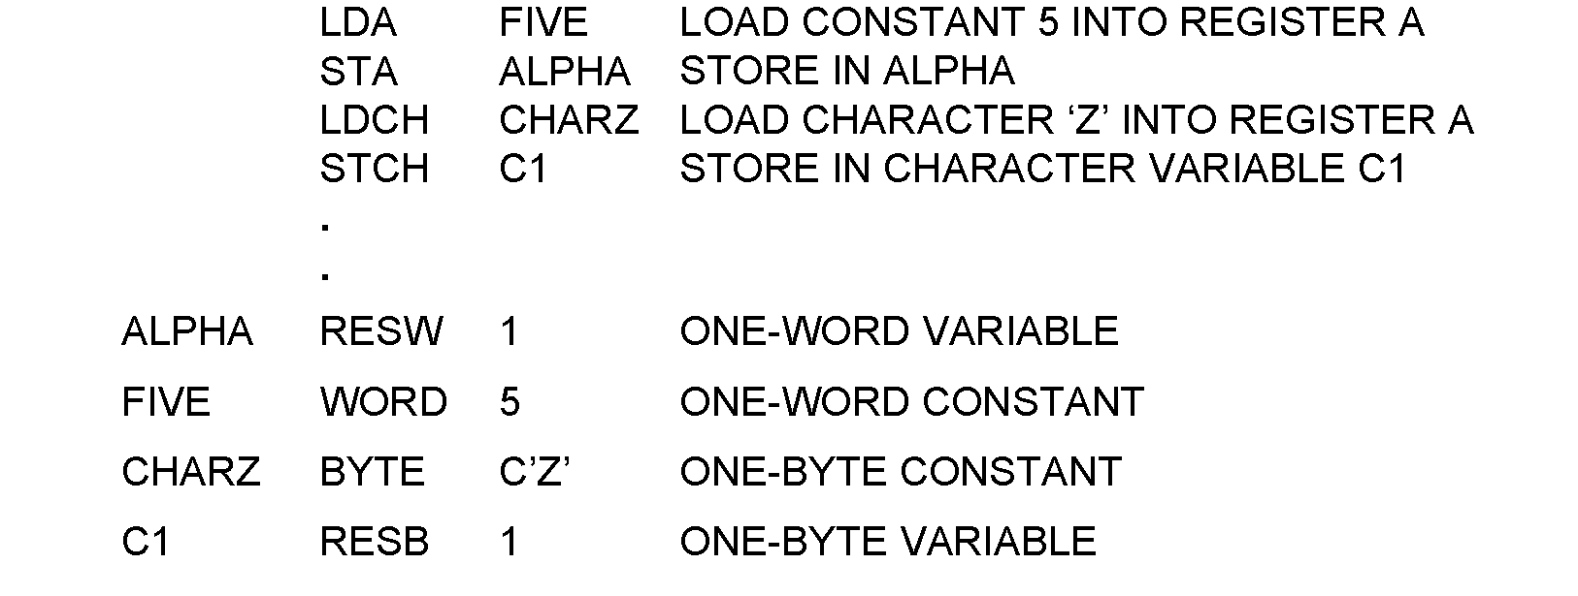
Sample Data Movement Operations
Notes:
There are no memory-to-memory move instructions. Hence all data movement are to be done using registersa

Slide 23
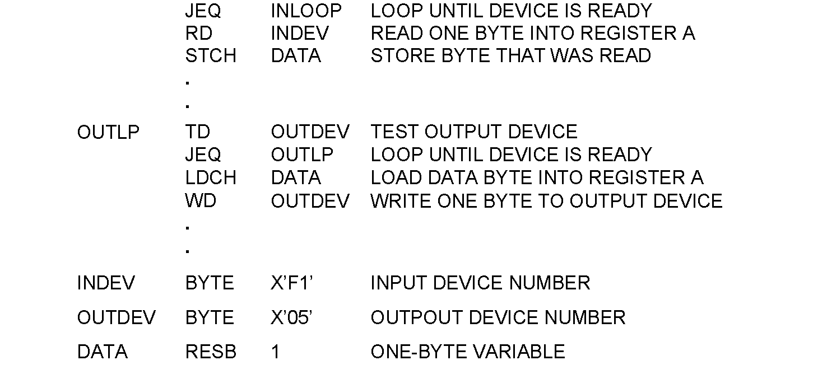
Sample Input and output operations for SIC
INLOOP TD INDEV TEST INPUT DEVICE

Slide 24
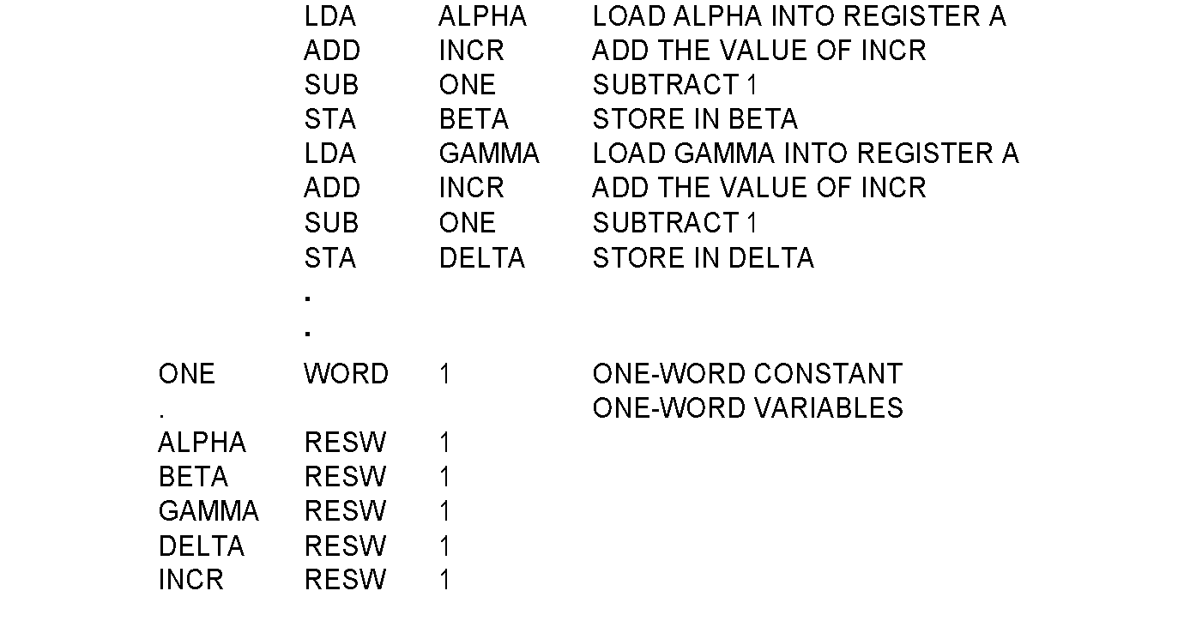
Programming examples - Arithmetic
BETA=ALPHA+INCR-1
DELTA=GAMMA+INCR-1

Slide 25
HOMEWORK
Write SIC instruction to add 2 and 4 and store it in variable SUM

Slide 26
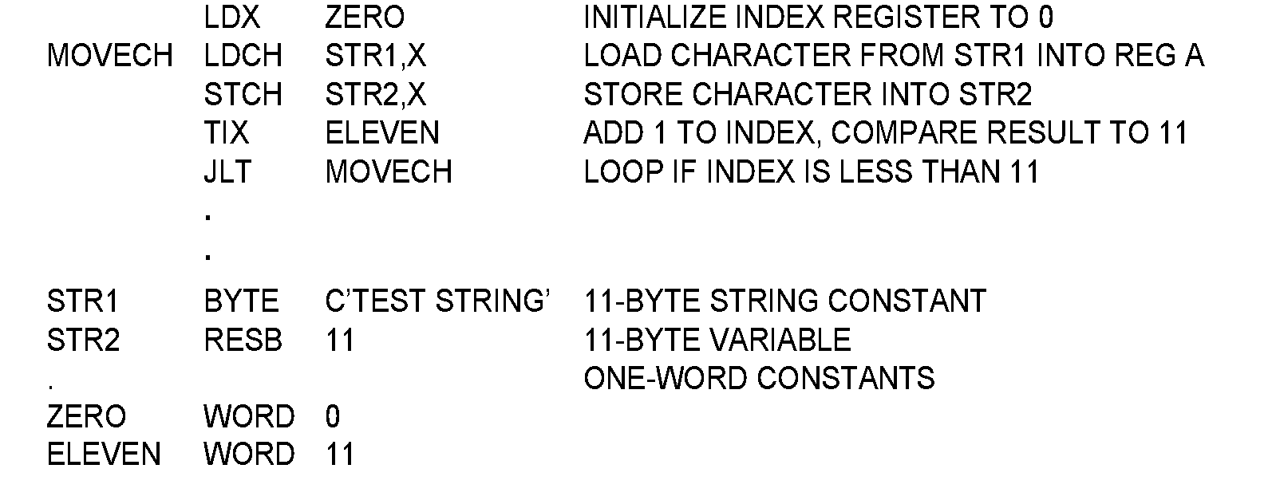
Programming examples -Looping and indexing
Program to Copy 11-byte string to another

Slide 27
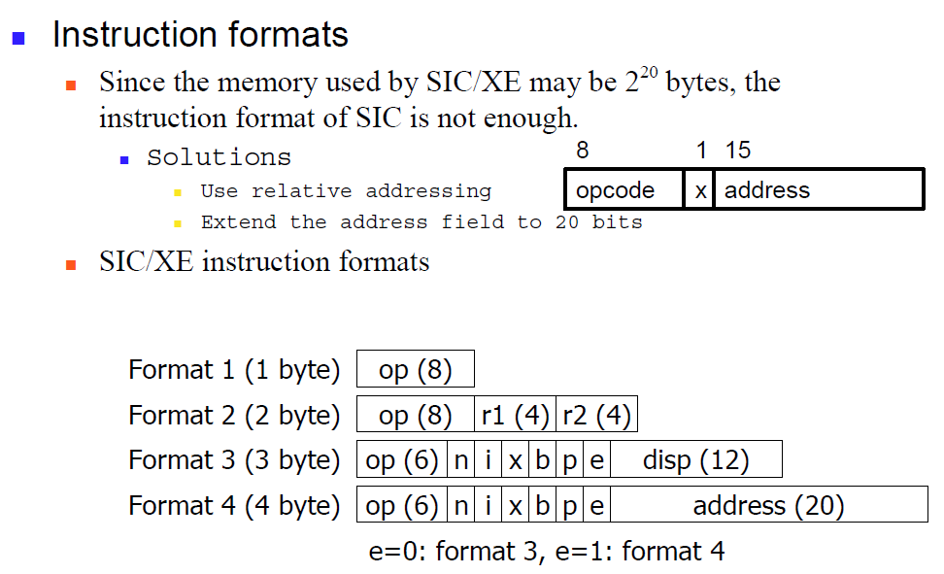
SIC/XE machine architecture

Slide 28
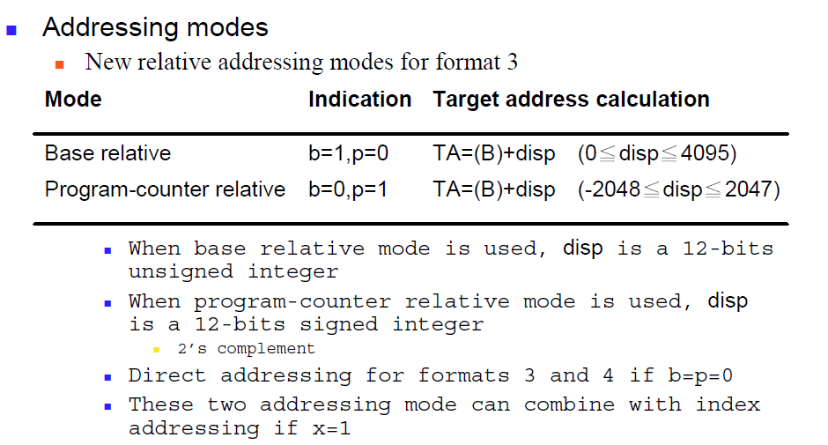
SIC/XE machine architecture

Slide 29
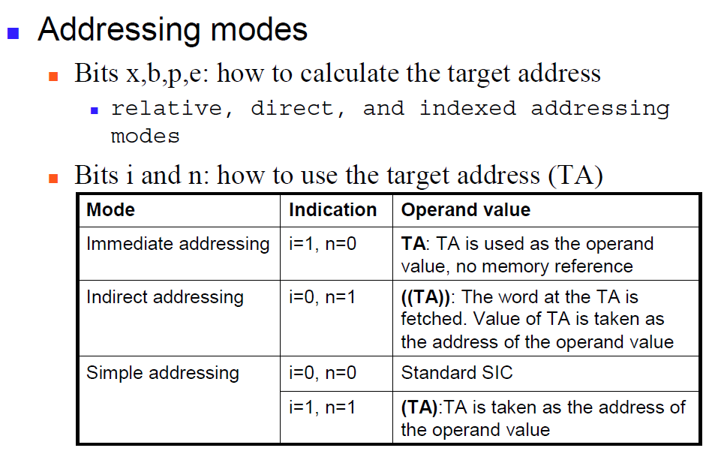
SIC/XE machine architecture

Slide 30
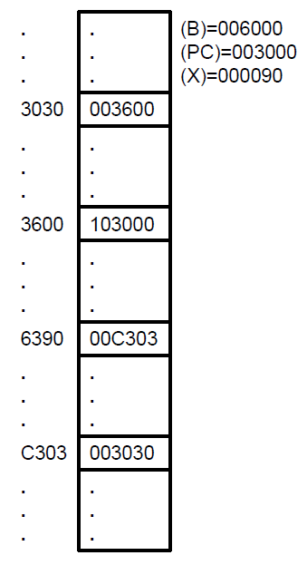
SIC/XE machine architecture
Give the target address generated for the following machine instruction:
032600H b) 03C300H c) 0310C303H d)022030 e)010030 f) 002600
Given (B)=006000, (PC)=003000, (X)= 000090 what is the content of register A after executing LDA instruction?

Slide 31
Solution
A) 032600H
No Indexing Format 3
Not Direct Not Immediate Program Counter Relative Addressing mode
Target Address=(PC)+displacement
= 003000+600
=003600
LDA Instruction when executed: the data stored in the target address 003600 that is 103000 is loaded to register A
OPCODE 6-BITS | N | I | X | B | P | E | DISPLACEMENT
0000 00 | 1 | 1 | 0 | 0 | 1 | 0 | 600

Slide 32
Solution
B) 03C300H
Indexing Format 3
Not Direct Not Immediate Base Relative Addressing mode
Target Address=(B)+(X)+ displacement
= 006000+000090+300
=006390
LDA Instruction when executed: the data stored in the target address 006390 that is 00C303 is loaded to register A
OPCODE 6-BITS | N | I | X | B | P | E | DISPLACEMENT
0000 00 | 1 | 1 | 1 | 1 | 0 | 0 | 300

Slide 33
Solution
C) 0310C303H
NO Indexing Format 4
Not Direct Not Immediate NO Relative Addressing mode
Target Address= displacement
= 0C303
LDA Instruction when executed: the data stored in the target address 0C303 that is 003030 is loaded to register A
OPCODE 6-BITS | N | I | X | B | P | E | DISPLACEMENT
0000 00 | 1 | 1 | 0 | 0 | 0 | 1 | 0C303

Slide 34
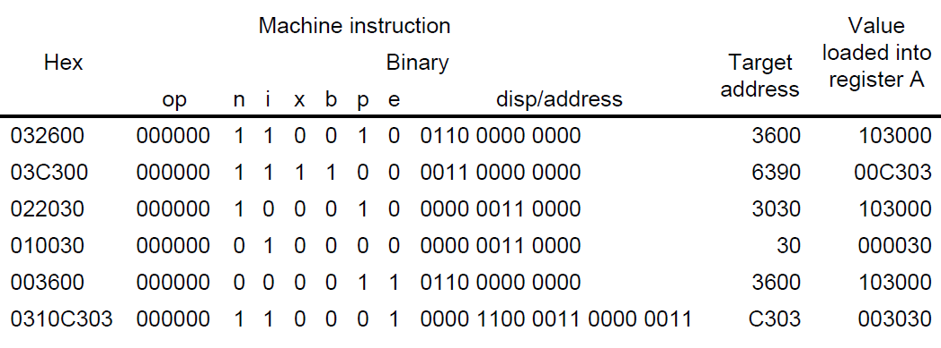
SIC/XE machine architecture
This gives machine code for the series of LDA instruction. Target Address generated by each instruction and the value loaded into register A

Slide 35
Instruction set
Standard SIC’s instruction
Load and store registers (B, S, T, F)
LDB, STB, …
Floating-point arithmetic operations
ADDF, SUBF, MULF, DIVF
Register-register arithmetic operations
ADDR, SUBR, MULR, DIVR
Register move operations
RMO
Supervisor call (SVC)
generates an interrupt for OS (Chap 6)
Input/Output
SIO, TIO, HIO: start, test, halt the operation of I/O device

Slide 36
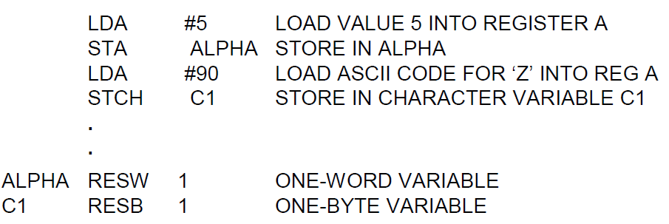
Programming examples - Data movement

Slide 37
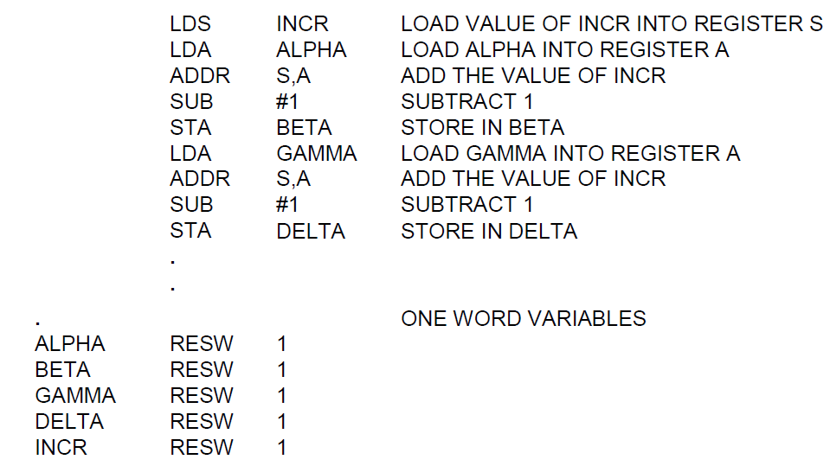
Programming examples (SIC/XE) - Arithmetic

Slide 38
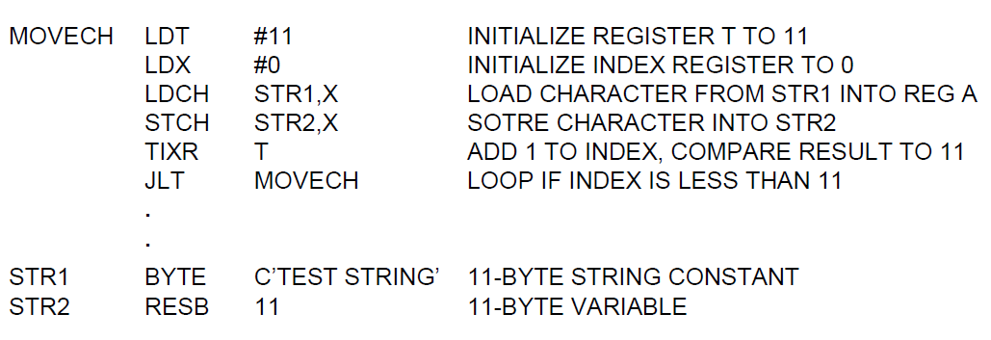
Programming examples (SIC/XE) -Looping and indexing

Slide 39
Introduction
Assembler
is a program that converts an assembly language program to its equivalent object program
Source program Object program
Object Program consists of:
Object code (also called Machine code)
Instructions to the loader
ASSEMBLER

Slide 40
Basic assembler functions
Translating mnemonic language code to its equivalent object code.
Assigning machine addresses to symbolic labels.
Process the Assembler Directive
START, END, BYTE, WORD, RESB,RESW

Slide 41
Assembler directive
Assembler directives are pseudo instructions
They provide instructions to the assembler itself
They are not translated into machine operation codes
SIC assembler directive
START : specify name & starting address
END : end of source program, specify the first execution instruction
BYTE, WORD, RESB, RESW
End of record : a null char (00)
End of file : a zero-length record

Slide 42
Translation of Source program to Object code requires:
Convert mnemonic operation codes to their machine language equivalents
Example: STL is converted to 14
Convert constants to equivalent machine representation
Example: 4095 is converted to FFFH
Build machine instruction using appropriate format
Example: LDA #4095 is converted to Machine code as follows Opcode for LDA =00
(4095)₁₀ =(FFF)₁₆
OPCODE (6-bits) | N | I | X | B | P | E | Displacement (12-bits)
0000 00 | 0 | 1 | 0 | 0 | 0 | 0 | 01 0F FF

Slide 43
Translation of Source program to Object code requires:
Convert Symbolic operands to their equivalent machine address
Example: RETADR is converted to 1033
Write the object program and the assembly listing

Slide 44
Object Program:
The object code along with the instruction given to Loader is called as object program
Format of Object program:
Header Record
Text Record
End Record

Slide 45
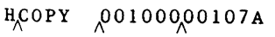
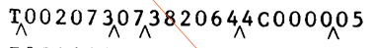
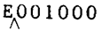
Format of the Object Program:
Format of Object program:
Header Record: Contains the name of the program, starting address and length of the object code.
Col. 1 H
Col. 2-7 Program name
Col. 8-13 Starting address of object program (hex)
Col. 14-19 Length of object program in bytes (hex)
Text Record: Contains the machine code along with the data of the program. Also contains the information at which memory address the object code and data has to be loaded and number of bytes to be copied into memory.
Col. 1 T
Col. 2-7 Starting address for object code in this record (hex)
Col. 8-9 Length of object code in this record in bytes (hex)
Col. 10-69 Object code, represented in hex (2 col. per byte)
End Record: indicates the end of the object program and contains the starting address of the first instruction to be executed
Col.1 E
Col.2-7 Address of first executable instruction in object program (hex)

Slide 46
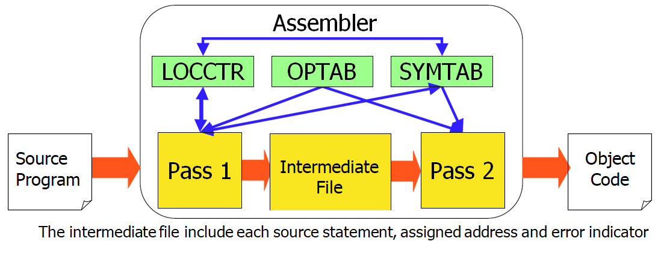
Data structures of the assembler
OPTAB: Operation code table
SYMTAB: symbol table
LOCCTR: location counter

Slide 47
OPTAB: Operation Code table consists of:
Mnemonic : contains symbolic representation of machine instruction
Mnemonic operation codes ⇔ Machine code
Format: Gives the length of the instruction
Opcode: contains the operation code
Mnemonic | Format | Opcode
ADD m | 3|4 | 18
ADDF m | 3|4 | 58
LDA m | 3|4 | 00
Implementation
It is a static table
Array or hash table
Usually use a hash table (mnemonic opcode as key)

Slide 48
LOCCTR
■ Initialize to be the beginning address specified in the “START” statement
■ LOCCTR ← LOCCTR + (instruction length)
■ The current value of LOCCTR gives the address to the label encountered

Slide 49
SYMTAB
Label name ⇔ label address, type, length, flag
To indicate error conditions (Ex: multiple define)
It is a dynamic table
Insert, delete and search
Usually use a hash table
The hash function should perform non-random key
(Ex: LOOP1, LOOP2, X,Y, Z)

Slide 50
Types of Assembler
Two Pass Assembler: The assembler that makes two passes [scans the program twice]
1st pass: scans the source program to find the address of each label and also assigns the address to each instruction
2nd pass: scans the source program and obtains the machine code for each instruction and generates object program
Single Pass assembler: The assembler that makes only one pass. Also called as one pass assembler.
Load and go assembler
Multi pass assembler: The assembler that makes more than two passes

Slide 51
The two passes of an assembler
Pass 1 (define symbols)
Assign addresses to all statements in the program
Save the addresses assigned to all labels for use in Pass 2
Perform assembler directives, including those for address assignment, such as BYTE and RESW
Pass 2 (assemble instructions and generate object program)
Assemble instructions (generate opcode and look up addresses)
Generate data values defined by BYTE, WORD
Perform processing of assembler directives not done during Pass 1
Write the object program and the assembly listing

Slide 52
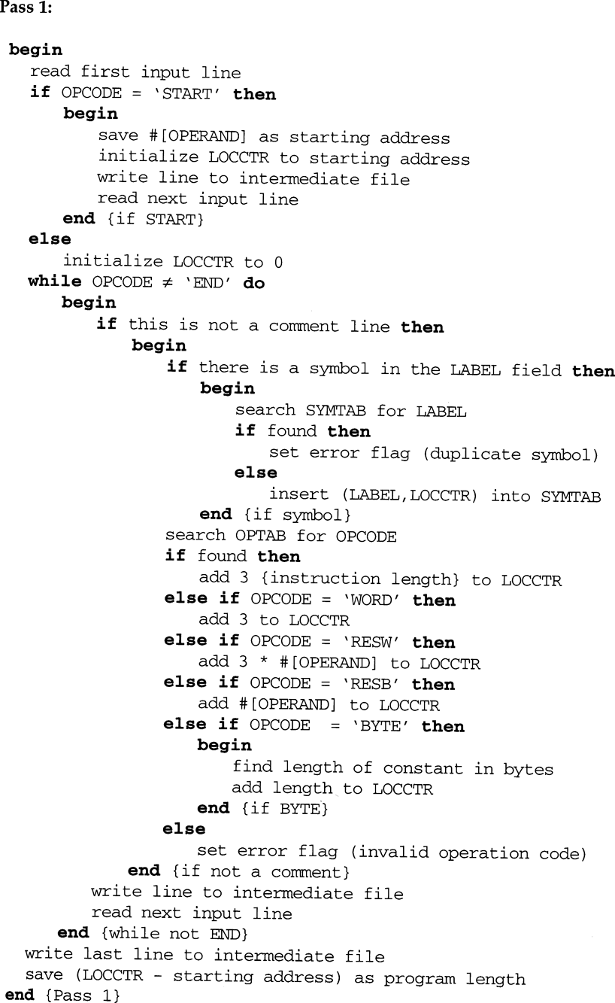
Assembler ALGORITHM: PASS-1

Slide 53
Assembler ALGORITHM: PASS-1
The algorithm scans the first statement START and saves the operand field (the address) as the starting address of the program. Initializes the LOCCTR value to this address. This line is written to the intermediate line.
If no operand is mentioned the LOCCTR is initialized to zero. If a label is encountered, the symbol has to be entered in the symbol table along with its associated address value.
If the symbol already exists that indicates an entry of the same symbol already exists. So an error flag is set indicating a duplication of the symbol.
It next checks for the mnemonic code, it searches for this code in the OPTAB. If found then the length of the instruction is added to the LOCCTR to make it point to the next instruction.
If the opcode is the directive
WORD then LOCCTR= LOCCTR+3
RESW it needs to add the number of data word to the LOCCTR.
BYTE it adds a value one to the LOCCTR, I
RESB it adds number of bytes.
If it is END directive then it is the end of the program it finds the length of the program by evaluating current LOCCTR – the starting address mentioned in the operand field of the END directive. Each processed line is written to the intermediate file.

Slide 54
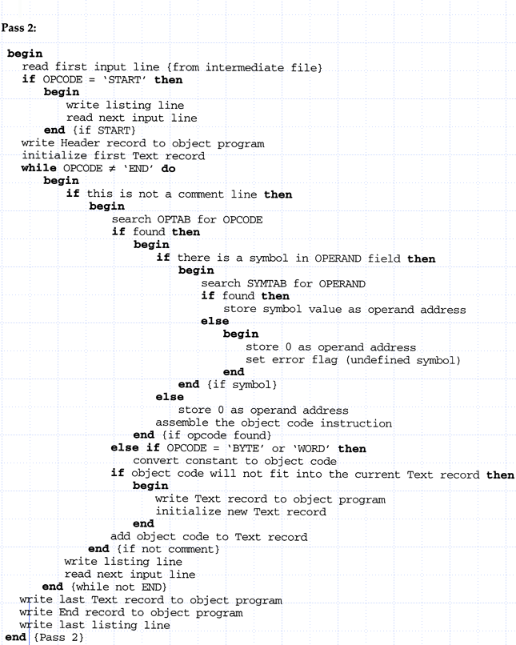
PASS-2

Slide 55
Pass-2
The first input line is read from the intermediate file
If the mnemonic is START it is directly written to listing file
A header record consists of program name, starting address and length of the object code
First text record is initialized
OPTAB is searched for mnemonic
If a symbol is present in the operand field, symbol is searched in the symbol table
If opcode is BYTE/WORD, then the constant value is converted to its equivalent object code

Slide 56
Labels:
Object code can be easily generated when the labels are defined before they are used as operands.
If the labels are defined earlier, the assembler can translate that instruction into equivalent object code [because the address of the operand is already known]
Example:
Backward reference to label
RETADR is defined before it is used as operands.
Address of RETADR=
(1000)₁₆ =(0001 0000 0000 0000)₂
discard MSB
Now the instruction:
STL RETADR
(14 10 00) object code
Location | Label | Mnemonics | Operands
 |  | ………
 |  | ………
1000 | RETADR | RESW | 1
 |  | ……
 |  | …....
 |  | STL | RETADR
Opcode | X | 15-bit address
14 | 0 | 001 0000 0000 0000

Slide 57
Forward Reference
The labels that are used in operand fields are defined later in the program.
Example: NUM is used as operand for Instruction LDA
NUM is not yet defined. It is defined in later part of the program. This is called as Forward Reference .
Location | Label | Mnemonics | Operands
1000 |  | LDA | NUM
 |  | ………
 |  | ………
 |  | ……….
1020 | NUM | WORD | X’112233’
Forward reference label

Slide 58
Example program (Figure 2.1 pp. 45)

Slide 59
Forward Reference
To Resolve the problem of Forward Reference:
We require address of NUM which is used in operand field of the instruction LDA
This instruction has forward reference for NUM
Difficult to assemble this instruction
Hence 2 pass assemblers are required.
1st pass: scans the source program to find the address of each label and also assigns the address to each instruction
2nd pass: scans the source program and obtains the machine code for each instruction and generates object program

Slide 60
Generate the complete Object program for the following: DELTA=GAMMA+INCR-1
SIC/XE program for
SOURCE STATEMENT
ARTH | START | 4000
 | LDA | GAMMA
 | ADD | INCR
 | SUB | ONE
 | STA | DELTA
DELTA | RESW | 1
GAMMA | RESW | 1
INCR | RESW | 1
ONE | WORD | 1
 | END
OPTAB
MNEMONIC | OPCODE
LDA | 00
ADD | 18
SUB | 1C
STA | 0C
Assume the following opcodes

Slide 61
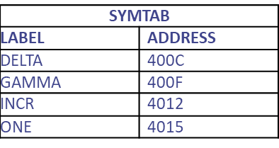
SOLUTION:
Pass-1:
Find the length of each instruction.
[=3 because it’s a SIC program]
Find the length of the data area
Initialize LOCCTR [Location Counter] and update it based on instruction length of data area
Find the length of the program in Bytes.
LOCCTR | LENGTH | SOURCE STATEMENT
 |  | ARTH | START | 4000
4000 | 3 | FIRST | LDA | GAMMA
4003 | 3 |  | ADD | INCR
4006 | 3 |  | SUB | ONE
4009 | 3 |  | STA | DELTA
400C | 3 | DELTA | RESW | 1
400F | 3 | GAMMA | RESW | 1
4012 | 3 | INCR | RESW | 1
4015 | 3 | ONE | WORD | 1
4018 | 3 |  | END | FIRST
Given
LOCCTR-Starting address
4018-4000
=18 bytes
Symbol table generated after pass-1

Slide 62
SOLUTION:
Pass-2
Get opcode from OPTAB and address of symbolic operands from SYMTAB and generate the object code using the following format
The complete object program for the given SIC is
Instruction | Opcode 8-bits | X | Address 15-bits | Object Code
LDA GAMMA | 0000 0000 | 0 | 100 0000 0000 1111 | 00400F
ADD INCR | 0001 1000 | 0 | 100 0000 0001 0010 | 184012
SUB ONE | 0001 1100 | 0 | 100 0000 0001 0101 | 1C4015
STA DELTA | 0000 1100 | 0 | 100 0000 0000 1100 | 0C400C
HARTH 004000000018 T0040000C00400F1840121C40150C400C T00401503000001
E004000

Slide 63
Generate the complete Object program for the following:
SOURCE STATEMENT
SUM | START | 0
FIRST | CLEAR | X
 | LDA | #0
 | +LDB | #TOTAL
 | BASE | TOTAL
LOOP | ADD | TABLE,X
 | TIX | COUNT
 | JLT | LOOP
 | STA | TOTAL
COUNT | RESW | 1
TABLE | RESW | 2000
TOTAL | RESW | 1
 | END | FIRST
OPTAB
MNEMONIC | OPCODE
LDA | 00
LDB | 68
ADD | 18
TIX | 2C
JLT | 38
STA | 0C
CLEAR | B4
Assume the following opcodes

Slide 64
SOLUTION:
Pass-1:
Find the length of each instruction.
Register as 1st operand=2 bytes
2 operand registers =2 bytes
Symbol as the operand=3 bytes
Preceding with + =4 bytes
Find the length of the data area
Initialize LOCCTR [Location Counter] and update it based on instruction length of data area
Find the length of the program in Bytes.
LOCCTR | LENGTH | SOURCE STATEMENT
 |  | SUM | START | 0
0000 | 2 | FIRST | CLEAR | X
0002 | 3 |  | LDA | #0
0005 | 4 |  | +LDB | #TOTAL
 |  |  | BASE | TOTAL
0009 | 3 | LOOP | ADD | TABLE,X
000C | 3 |  | TIX | COUNT
000F | 3 |  | JLT | LOOP
0012 | 3 |  | STA | TOTAL
0015 | 3 | COUNT | RESW | 1
0018 | 1770 | TABLE | RESW | 2000
1788 | 3 | TOTAL | RESW | 1
178B |  |  | END | FIRST
Given
LOCCTR - Starting address
178B - 0000
=178B H
TABLE RESW 2000
This instruction has to reserve 2000*3bytes=6000 bytes
Hence , (6000)₁₀ =(1770)₁₆
SYMTAB
LABEL | ADDRESS
FIRST | 0000
LOOP | 0009
COUNT | 0015
TABLE | 0018
TOTAL | 1788
Symbol table generated after pass-1

Slide 65
SOLUTION:
Pass-2: Get opcode from OPTAB and address of symbolic operands from SYMTAB and generate the object code using the following format
Instruction |  | Instruction Format | Object code |  |  |  |  |  |  |  |  |  | Remarks
CLEAR | X | 2 byte | B | 4 |  | 1 Reg x value |  |  |  | 0 No 2nd operand |  |  | The value of the register X=1 B410
LDA | #0 | 3 bytes | 01 |  |  |  |  | 0000 |  |  |  |  | 010000
+LDB | #TOTAL | 4 bytes | Opcode 6-bits |  | N | I | X | B | P |  | E | Address | Address of TOTAL is taken from the SYMTAB 69101788
 |  |  | 0011 1000 |  | 0 | 1 | 0 | 0 | 0 |  | 1 | 01788
BASE | TOTAL | BASE is an Assembler directive Indicating that it is base addressing mode and (Total) is considered for Base reg.
ADD | TABLE,X | 3 bytes | Opcode 6-bits |  | N | I | X | B | P |  | E | Address | Displacement Address=TABLE-PC = 0018-000C= C = 1BA00C
 |  |  | 0001 1000 |  | 1 | 1 | 1 | 0 | 1 |  | 0 | 00C
TIX | COUNT | 3 bytes | Opcode 6-bits |  | N | I | X | B | P |  | E | Address | Displacement Address=COUNT-PC = 0015-000F= 6 = 2F2006
 |  |  | 0010 1100 |  | 1 | 1 | 0 | 0 | 1 |  | 0 | 006
JLT | LOOP | 3 bytes | Opcode 6-bits |  | N | I | X | B | P |  | E | Address | Displacement Address=LOOP-PC = 0009-0012= FF7 = 3D2FF7
 |  |  | 0011 1000 |  | 1 | 1 | 0 | 0 | 1 |  | 0 | FF7
STA | TOTAL | 3 bytes | Opcode 6-bits |  | N | I | X | B | P |  | E | Address | Displacement Address=TOTAL –(B) =1788-1788=0 0F4000
 |  |  | 0000 1100 |  | 1 | 1 | 0 | 1 | 0 |  | 0 | 000

Slide 66
Object Program
Final Object program:
H | SUM | 00000000178B
T | 000000 | 15B410010000691017881BA00C2F20063B2FF70F4000
E | 000000

Slide 67
Problem-1
Generate the object code for the program
ADDIT START 1500
LDA M OPTAB
ADD N
STA SUM
M WORD 2
N WORD 4
SUM RESW 1
END
Mnemonics | opcode
LDA | 00
ADD | 18
STA | 0C

Slide 68
Solution
LABEL | ADDRESS
M | 1509
N | 150C
SUM | 150F
LOCCTR | LENGTH | SOURCE STATEMENT |  |  | OBJECT CODE
 |  | ADDIT | START | 1500
1500 | 3 |  | LDA | M | 001509
1503 | 3 |  | ADD | N | 18150C
1506 | 3 |  | STA | SUM | 0C150F
1509 | 3 | M | WORD | 2
150C | 3 | N | WORD | 4
150F | 3 | SUM | RESW | 1
1512 | 3 |  | END

Slide 69
Object program
H^ADDIT ^001500^000012
T0015000F00150918150C0C150F0000002000004
E001500

Slide 70
Problem-2
Generate the object code for the program
LABEL | MNEMONICS | OPERANDS
TRANS | START | 1000
 | LDA | #5
 | STA | ALPHA
 | LDA | #90
 | STCH | C1
ALPHA | RESW | 1
C1 | RESB | 1
 | END
Mnemonics | opcode
LDA | 00
STCH | 54
STA | 0C

Slide 71
Solution
LABEL | ADDRESS
ALPHA | 100C
C1 | 100F
LOCCTR | LENGTH | SOURCE STATEMENT |  |  | OBJECT CODE
 |  | TRANS | START | 1000
1000 | 3 |  | LDA | #5 | 010005
1003 | 3 |  | STA | ALPHA | 0F2006
1006 | 3 |  | LDA | #90 | 01005A
1009 | 3 |  | STCH | C1 | 572003
100c | 3 | ALPHA | RESW | 1
100F | 1 | C1 | RESB | 1
1010 |  |  | END

Slide 72
LDA #5 format 3/4
opcode n i x b p e address
0000 00 0 1 0 0 0 0 0000 0000 00101
010005
STA ALPHA format 3/4
opcode n i x b p e address
0000 11 1 1 0 0 1 0 0000 0000 00110
disp=TA-(pc)
100C-1006=6
0F2006

Slide 73
LDA #90
opcode n i x b p e address
0000 00 0 1 0 0 0 0 0000 0101 1010
01005A
STCH C1
opcode n i x b p e address
0101 01 1 1 0 0 1 0 0000 0000 0011
disp=TA-(pc)
100f-100c=003
572003

Slide 74
HTRANS 00100000010
T000010090100050F200601005A572003
E001000

Slide 75
Problem-3
Generate the object code for the program
LABEL | MNEMONICS | OPERANDS
COPY | START | 1000
 | LDT | #11
 | LDX | #0
MOVECH | LDCH | STR1,X
 | STCH | STR2,X
 | TIXR | T
 | JLT | MOVECH
STR1 | BYTE | C'HELLO WORLD'
STR2 | RESB | 11
 | END
Mnemonics | opcode
LDT | 74
STCH | 54
LDX | 04
LDCH | 50
TIXR | B8
JLT | 38

Slide 76
Assemblers
2.2 Machine-dependent Assembler Features

Slide 77
Machine Dependent Assembler Features
Instruction format and addressing mode
Program relocation

Slide 78
Instruction format and addressing mode
The instruction formats of standard SIC model is:
Instruction format of standard SIC are
X BIT=0 Direct Addressing
ALPHA WORD X’112233’
LDA ALPHA
X BIT=1 Indexed Addressing
Target address of the data is obtained as:
TA= Address specified in the operand + (X)
OPCODE | X | ADDRESS
8-BITS | 1 | 15 BITS

Slide 79
Instruction format and addressing mode
The instruction formats of SIC/XE mode are:
Program Counter Relative Addressing
Base Relative Addressing
Immediate Addressing
Indirect Addressing
Register Addressing
Direct Addressing
Uses Instruction Format-3
Uses Instruction Format-2
Uses Instruction Format-4

Slide 80
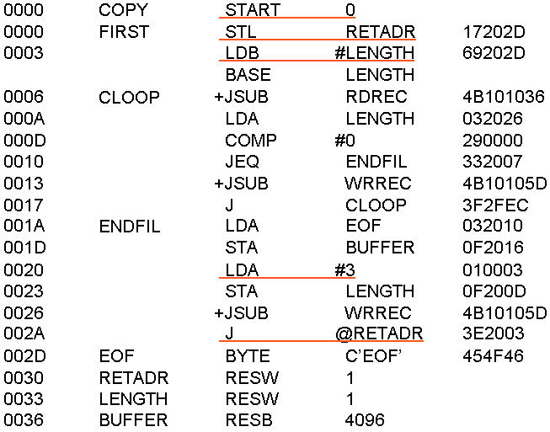
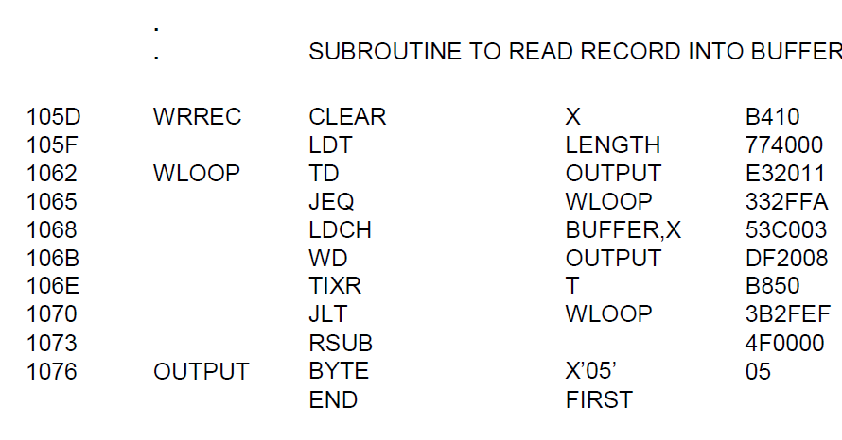
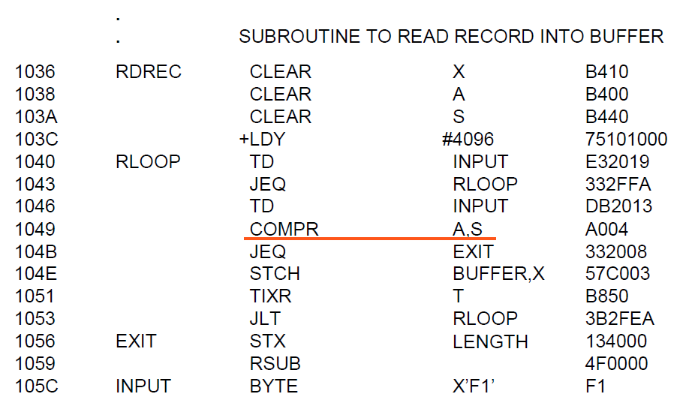
Sample SIC/XE program

Slide 81
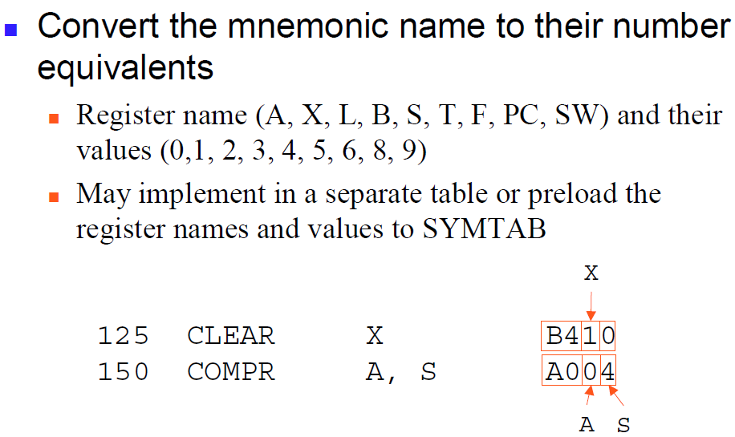
Register-Register addressing

Slide 82
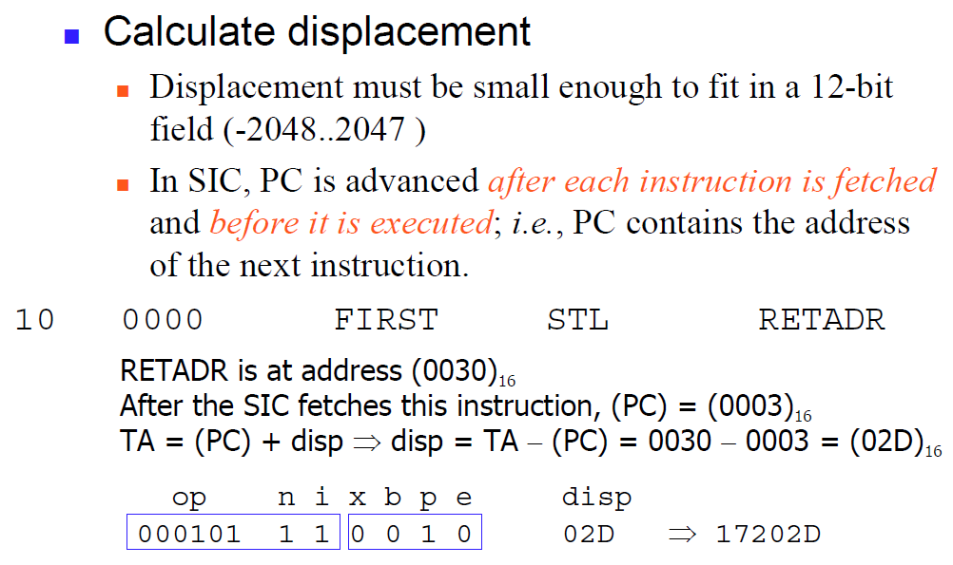
Program Counter Relative addressing

Slide 83
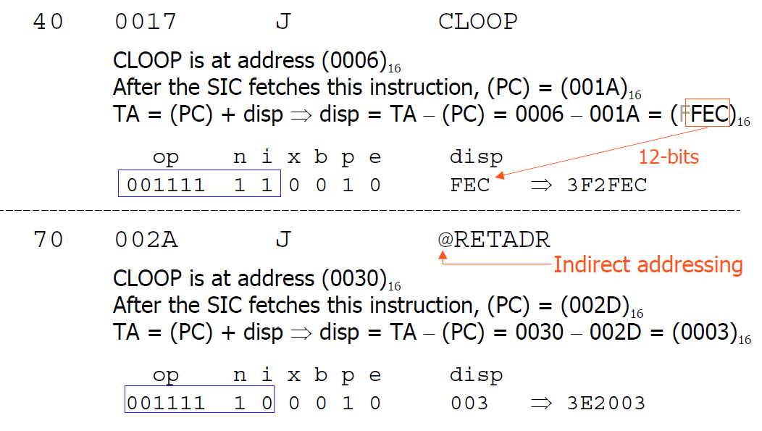
Program Counter Relative addressing

Slide 84
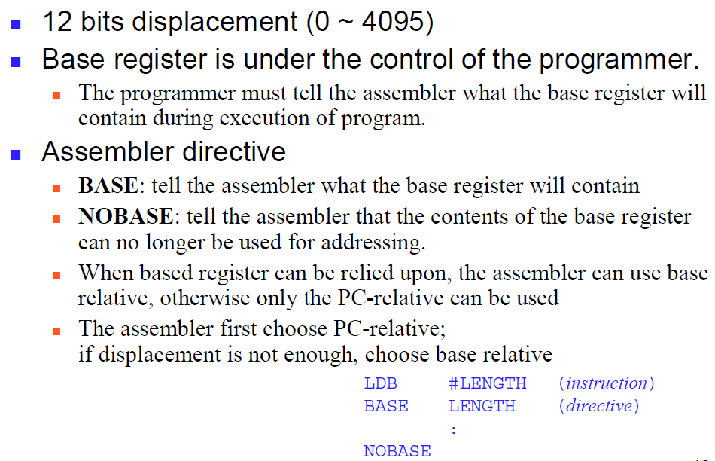
Base Relative addressing

Slide 85
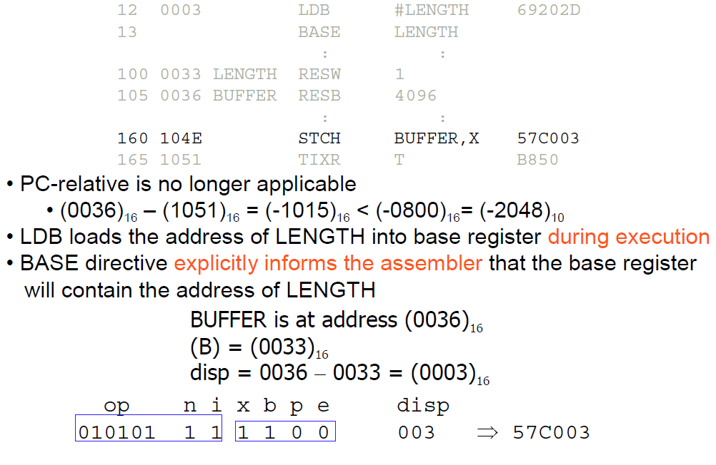
Base Relative addressing

Slide 86
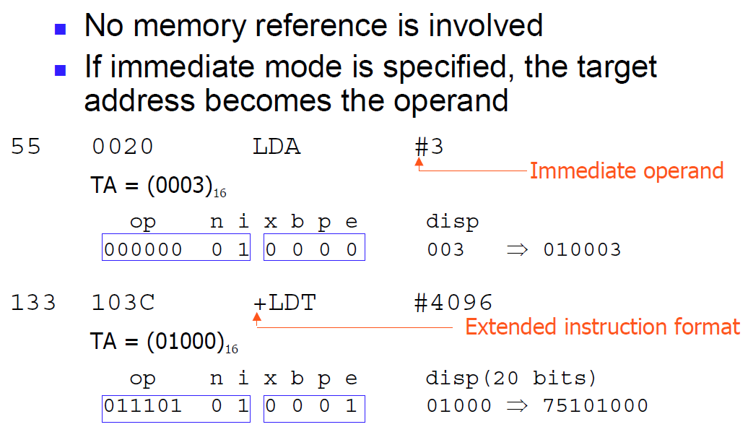
Immediate Addressing

Slide 87
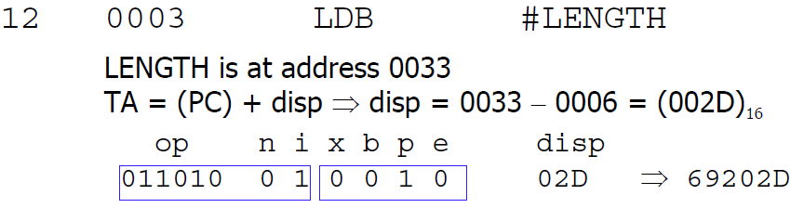
Immediate & PC-relative addressing

Slide 88
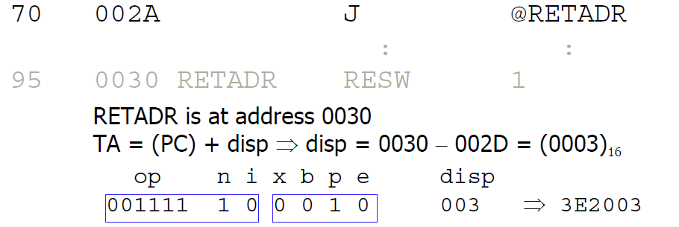
Indirect & PC-relative addressing

Slide 89
Instruction format and addressing mode
The instruction formats of SIC/XE mode are:
x=0 Not indexing x=1 indexing
n | i | Meaning | Example | Remarks
0 | 0 | Simple/direct |  | This mode uses format 4. Mnemonics have prefix by +
0 | 1 | Immediate addressing | LDA # 4095 | Data is preceded by #
1 | 0 | Indirect Addressing | +LDA @ALPHA, X | Operand is prefixed with @ TA=ALPHA+(x)
1 | 1 | Simple/direct |  | This bit pattern is normally used while assembling using direct addressing

Slide 90
Instruction format and addressing mode
The instruction formats of SIC/XE mode are:
e=0 format 3 e=1 format 4
b | p | Meaning | Displacement address | Remarks
0 | 0 | No relative addressing
0 | 1 | PC relative addressing | Disp= Target address - ProgramCounter | Displacement range is -2048 to 2047
1 | 0 | Base relative addressing | Disp= Target address - [Base register] | Displacement range is 0 to 4095
1 | 1 | Invalid

Slide 91
Addressing modes
Register as 1st operand
= 2 bytes
2 operand registers
= 2 bytes
Symbol as the operand
= 3 bytes
RSUB has length
= 3 bytes
Preceding with +
= 4 bytes
Program Counter Relative Addressing
Disp=TA-PC
Base Relative Addressing
Disp=TA-(base register)
Immediate Addressing
LDA #4095
Indirect Addressing
+LDA @ALPHA ,X
Register Addressing
Uses instruction format 2.
CLEAR A { 1 OPERAND REGISTER}
COMPR A,S { 2 OPERAND REGISTER}
Direct Addressing
+LDA ALPHA
+LDB #4096

Slide 92
Program Relocation
Why
It is desirable to load and run several programs at the same time
The system must be able to load programs into memory wherever there is room
The exact starting address of the program is not known until load time

Slide 93
Example:
LINE | LOCCTR | LABEL | MNEMONICS | OPERANDS | OBJECT CODE
5 |  | COPY | START | 1000
10 | 1000 | FIRST | STL | RETADR | 14 102D
… | …. | ….. | ……
 |  |  | …..
25 | 102D | RETADR | …. | …..
 |  | END | FIRST
Absolute Program
Program with starting address specified at assembly time
The address may be invalid if the program is loaded into somewhere else.

Slide 94
Program Relocation
Reload the program starting at 2000
The absolute address should be modified
The address of RETADR to be modofied as 202D

Slide 95
Program Relocation
The only parts of the program that require modification at load time are those that specify direct addresses
The rest of the instructions need not be modified
Not a memory address (immediate addressing)
PC-relative, Base-relative
From the object program, it is not possible to distinguish the address and constant
The assembler must keep some information to tell the loader
The object program that contains the modification record is called a relocatable program

Slide 96
Program Relocation
For an address label, its address is assigned relative to the start of the program (START 0)
Produce a Modification record to store the starting location and the length of the address field to be modified.
The command for the loader must also be a part of the object program

Slide 97
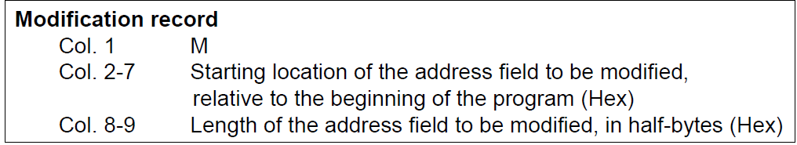
Program Relocation
One modification record for each address to be modified
The length is stored in half-bytes (4 bits)
The starting location is the location of the byte containing the leftmost bits of the address field to be modified.
If the field contains an odd number of half-bytes, the starting location begins in the middle of the first byte.

Slide 98
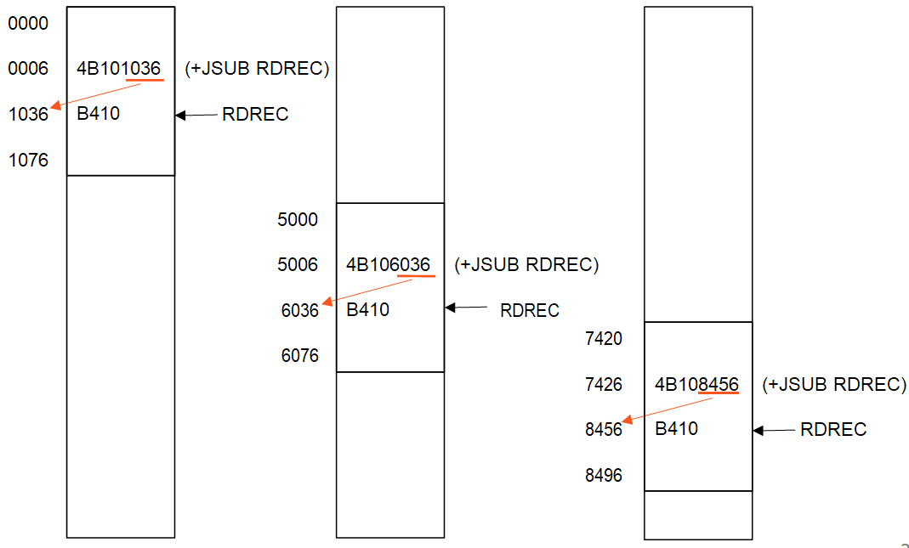
Program Relocation

Slide 99
Address calculation
JSUB=48 RDREC=1036
Opcode | N | I | X | B | P | E | Address
0100 10 | 1 | 1 | 0 | 0 | 0 | 1 | 01036
4B101036
4B | 10 | 10 | 36
0006 | 0007 | 0008 | 0009

Slide 100
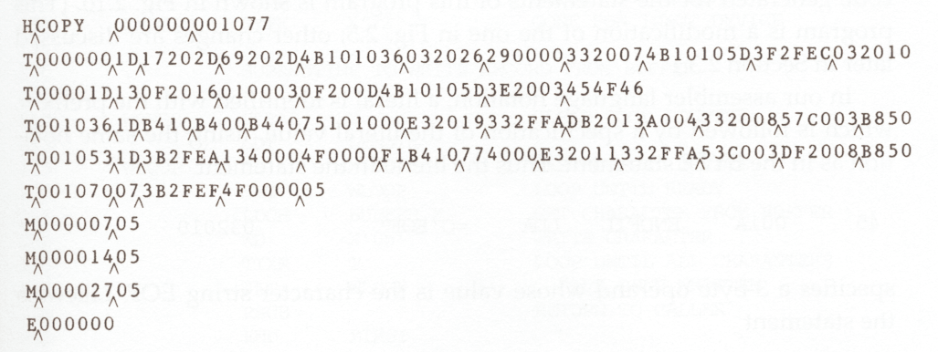
Relocatable Object Program

Slide 101
Assemblers
2.3 Machine-Independent Assembler Features

Slide 102
Machine-Independent Assembler Features
Literals
Symbol Defining Statements
Expressions
Program Blocks
Control Sections and Program Linking

Slide 103
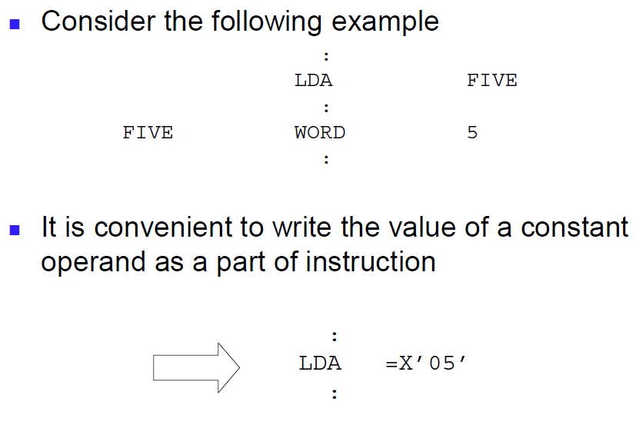
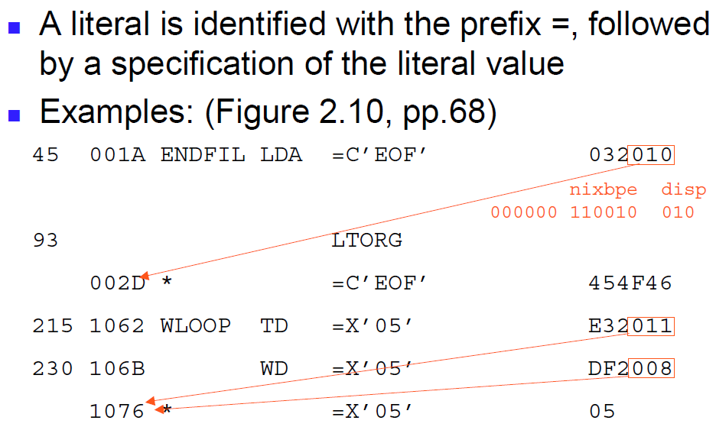
Literals

Slide 104
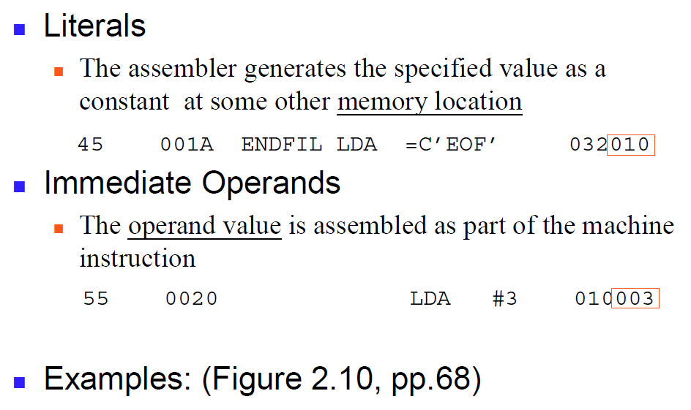
Literals v/s Immediate operands

Slide 105
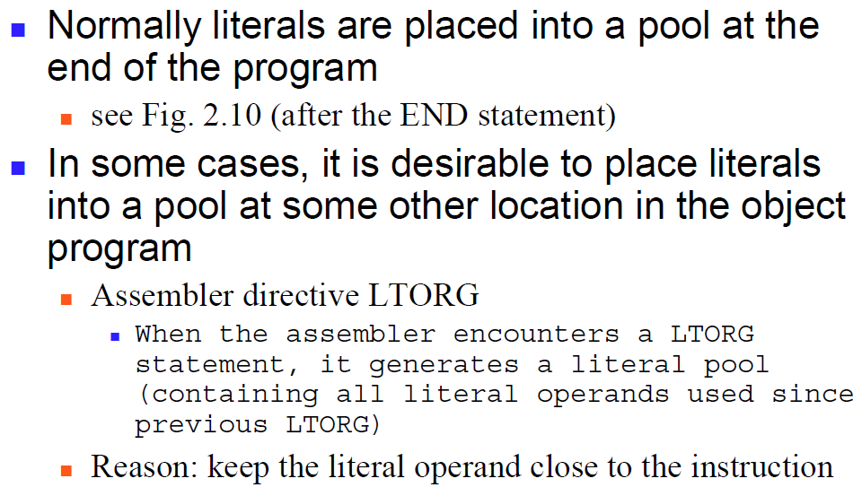
Literal pools

Slide 106
LTORG
Line# | LABEL | MNEMONICS | OPERANDS | REMARKS
5 | COPY | START | 0
 |  | .....
25 |  | LDA | =C'EOF' | The literal =C'EOF' will be defined and inserted from the place where LTORG is used.
 |  | ......
 |  | .......
50 |  | LTORG
 |  | ......
 |  | .......
70 |  | LDA | =C'ABC' | The literal =C'ABC' will be defined and inserted at the end of the program
 |  | ........
 |  | .........
90 |  | END | FIRST

Slide 107
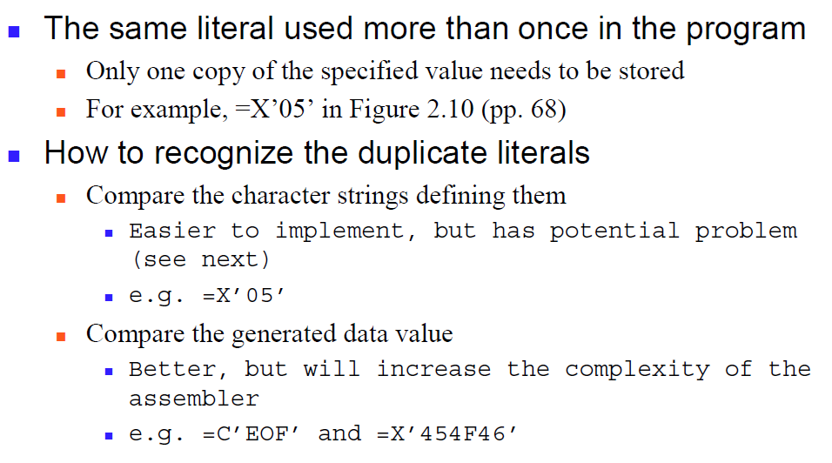
Duplicate Literals

Slide 108
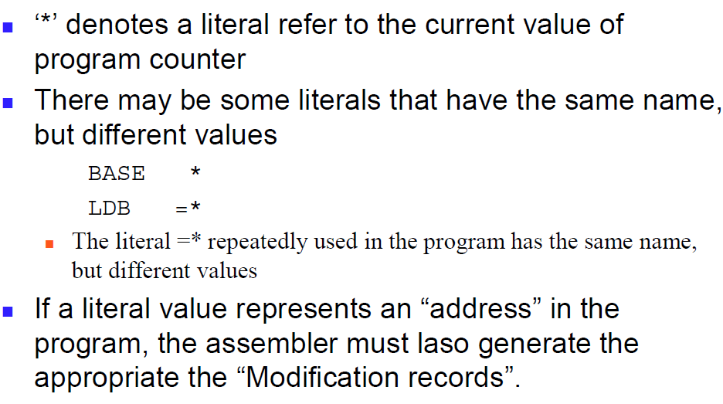
Problem of Duplicate literal recognition

Slide 109
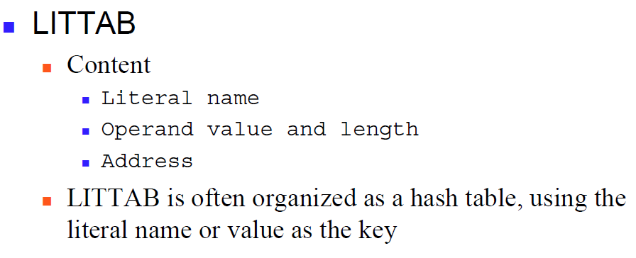
Literal Table
The literals are handled by the assembler using basic data structure called Literal Table identified by LITTAB

Slide 110
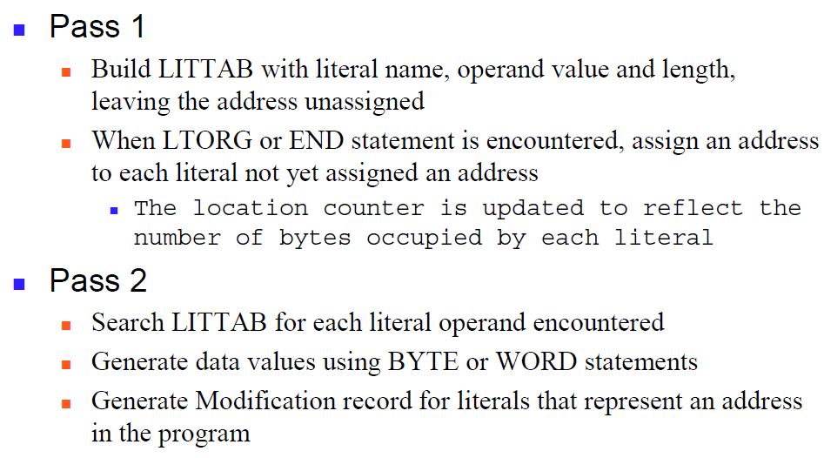
Implementation of literal Table

Slide 111
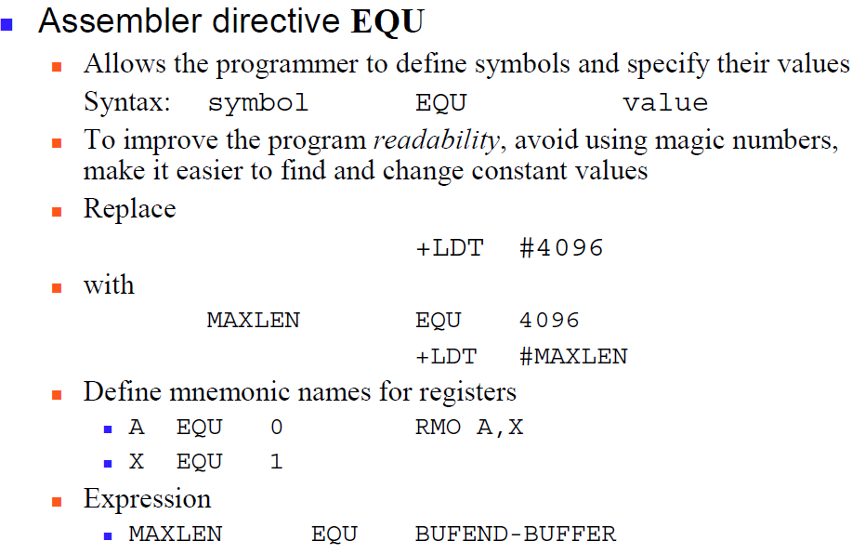
Symbol-Defining Statements
Notes:
How to specify the values for the symbols used in the program?
the progammer can define symbols and specify the values associated with symbols using the EQU and ORG assembler directives.

Slide 112
Assembler directive ORG
Allow the assembler to reset the PC to values
Syntax: ORG value LOCCTR to the specified value
When ORG is encountered, the assembler resets its
ORG will affect the values of all labels defined until the next ORG
If the previous value of LOCCTR can be automatically remembered, we can return to the normal use of LOCCTR by simply write ORG
Notes:
ORG is an assembler directive using which assembler indirectly assigns the values to the symbols by initializing the location counter with new value.

Slide 113
Example of ORG
Label | Mnemonics | Opernds | Remarks
COPY | START | 1000 | LOCCTR is assigned to 1000
FIRST | STL | RETADR
 | .........
 | .........
 | ORG | 3000 | LOCCTR is assigned to 3000 Assembler uses this new value as the LOCCTR m this point onwards.
SECOND | STA | LENGTH
 | ...........
 | ...........

Slide 114
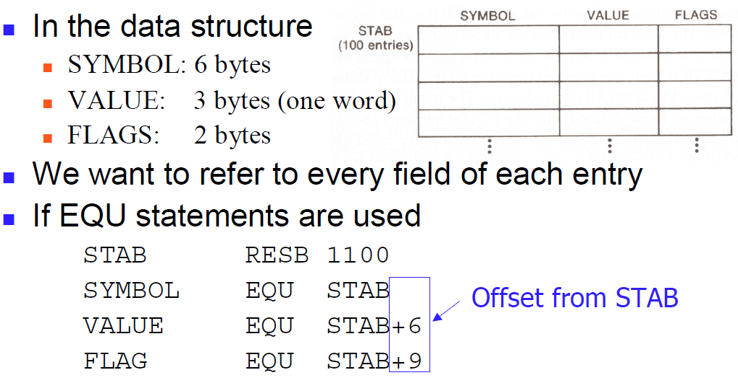
Example: using ORG

Slide 115
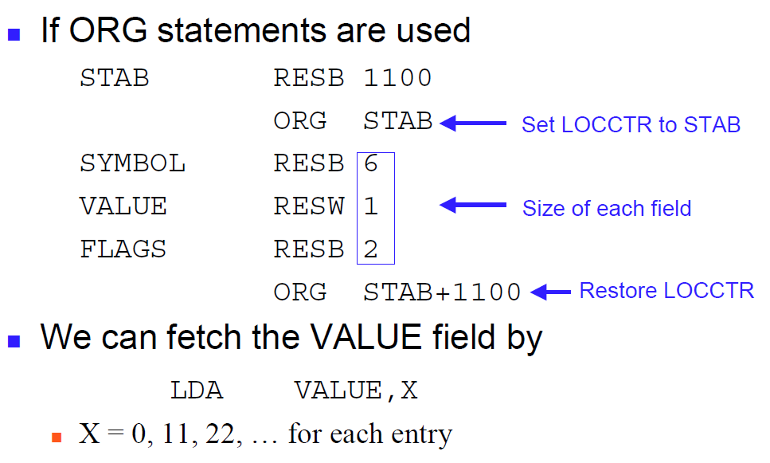
Example: using ORG

Slide 116
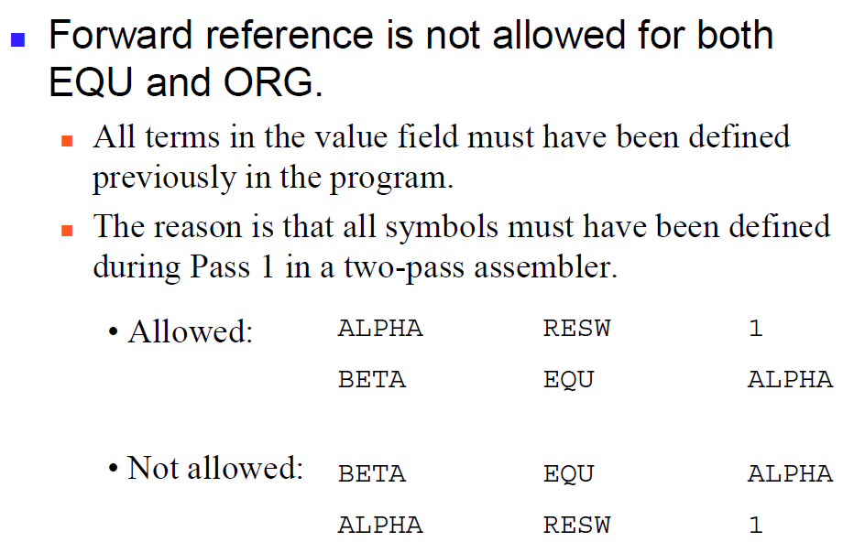
Forward-Reference Problem

Slide 117
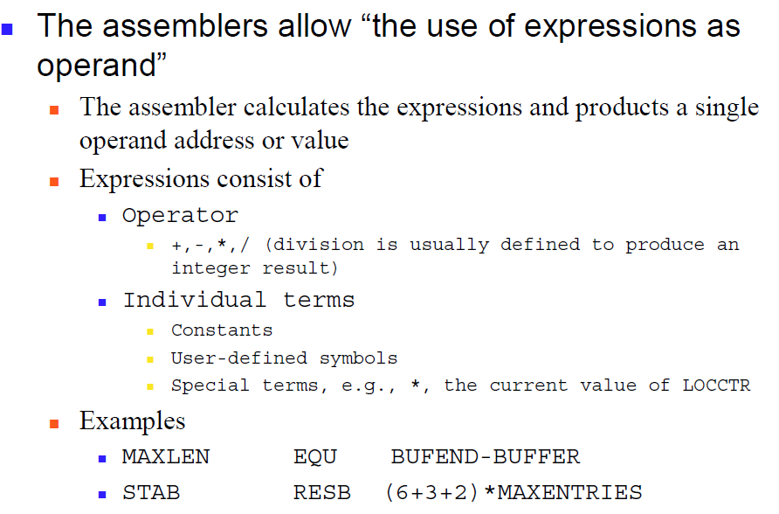
Expression

Slide 118
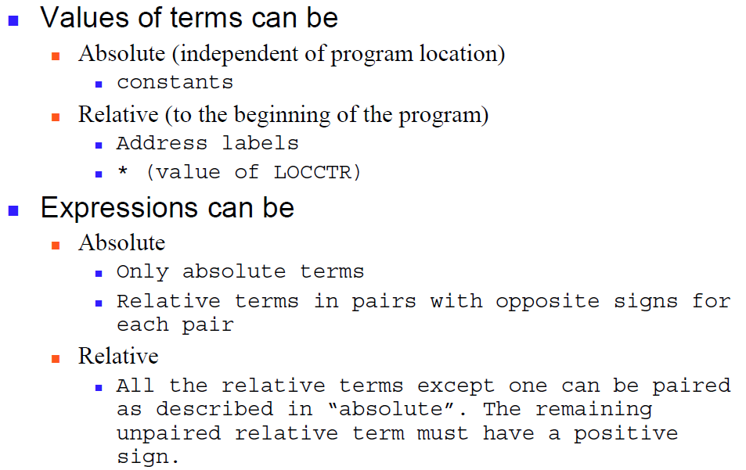
Types of Expressions

Slide 119
Absolute Expression
Expression that contains only absolute terms
Example:
MAXLEN EQU 1024
MAXLEN EQU 1024+5
may consists of relative terms which occurs in pairs and the terms in each such pair have opposite signs
MAXLEN EQU BUFEND-BUFFER
START=0 BUFEND=0055 and BUFFER= 0050 then BUFEND-BUFFER=05 START=1000 BUFEND=1055 and BUFFER= 1050 then
BUFEND-BUFFER=05

Slide 120
Relative Expression
The expression whose value changes relative to the current location value, is called relative expression.
Example:
Expression with * indicates the current value is used.
If START=0 then BUFEND has a value 0055
If START=1000 then BUFEND has a value 1055
Hence BUFEND is relative and therefore MAXLEN
LOCCTR | Label | Mnemonic | Operand
 | COPY | START | 0
0000 |  | ........
...... |  | ........
0050 | BUFFER | RESB | 05
0055 | BUFEND | EQU | *
 | MAXLEN | EQU | BUFEND

Slide 121
Restriction of Relative Expressions
No relative terms may enter into a multiplication or division operation
Expressions that do not meet the conditions of either “absolute” or “relative” should be flagged as errors.

Slide 122

Handling Relative Symbols in SYMTAB

Slide 123
Program Block
Program Block is a method of allowing the machine instructions and data appear in the object program in different order than the order in which the corresponding instructions are specified in the source program.
Program Blocks allows more flexibility to the source program and object program.

Slide 124

Program Blocks

Slide 125

Program blocks

